Slide 1
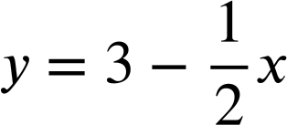
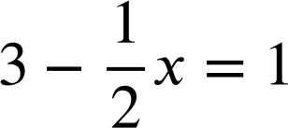
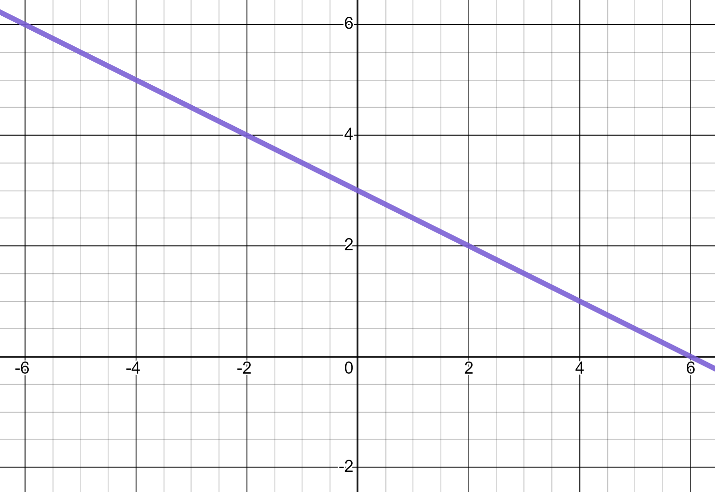
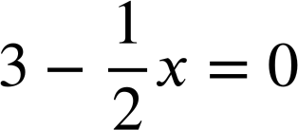
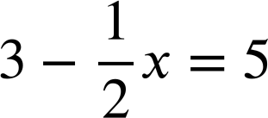
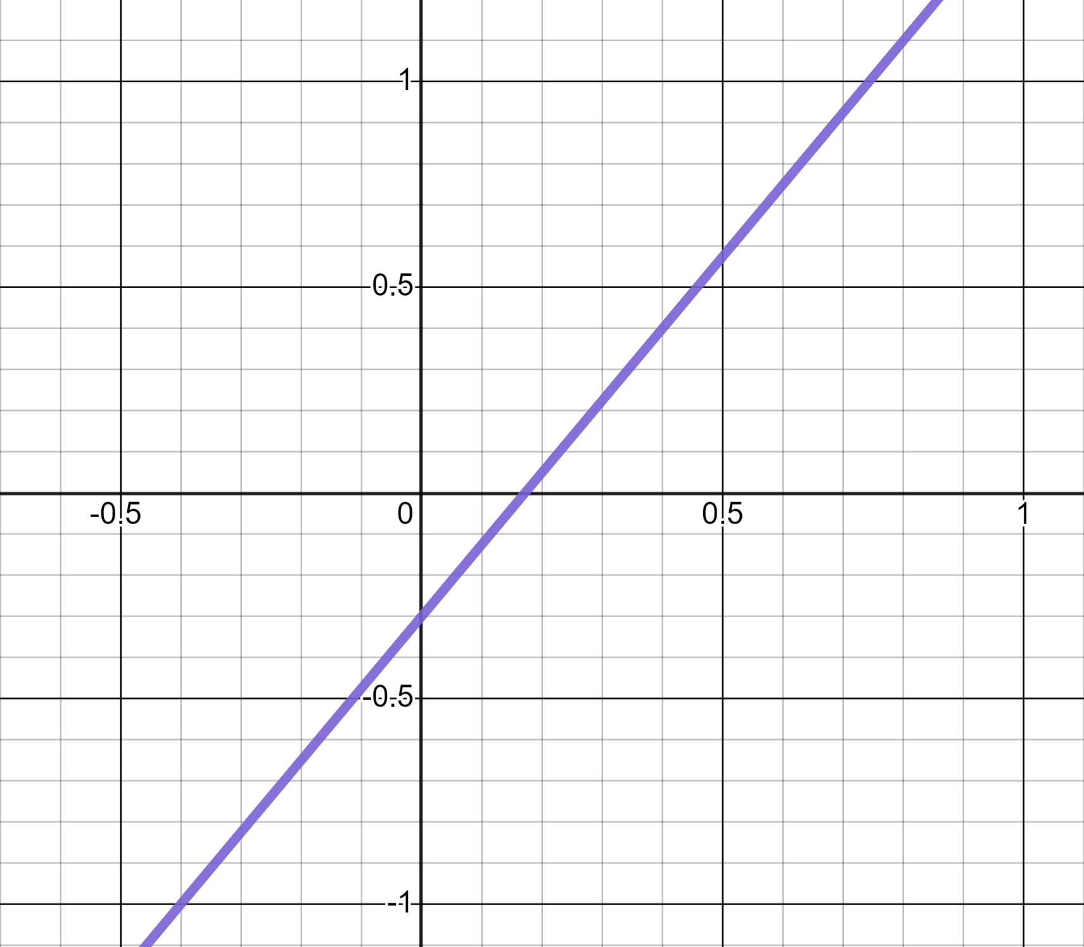
Reading from graphs
Task A: Reading from linear graphs
1) Use this graph of to solve these equations.
a)
x = 4
y
(−4, 5)
✖
b)
x = 6
(4, 1)
✖
c)
x = −4
✖
x
(6, 0)
2) Use this graph of y = 1.75x − 0.3 to calculate:
a) 1.75 × 0.8 − 0.3 = 1.1
y
✖
(0.8, 1.1)
b) 1.75 × 0.4 − 0.3 = 0.4
✖
(0.4, 0.4)
x
c) 1.75 × −0.4 − 0.3 = −1
(−0.4, −1)
✖

Slide 2
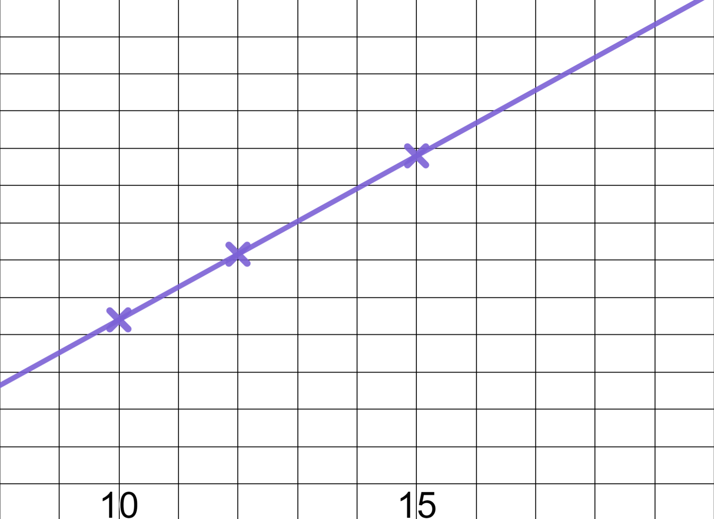
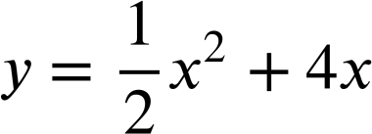
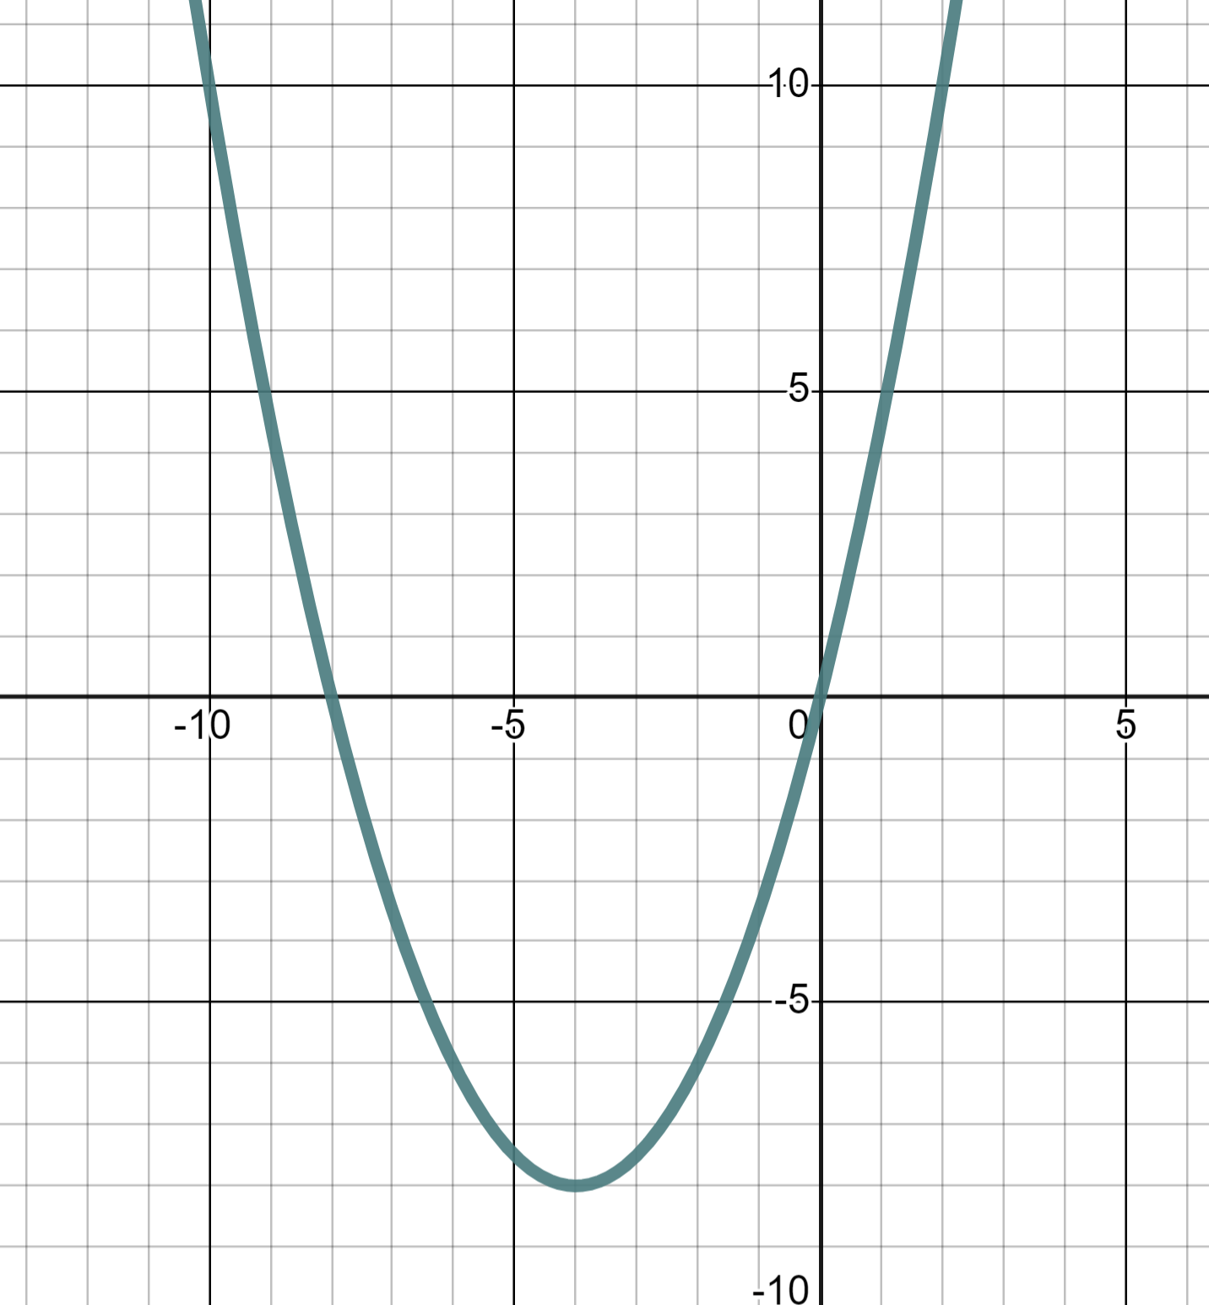
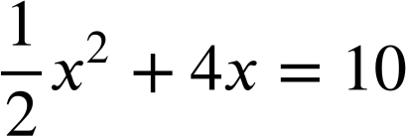
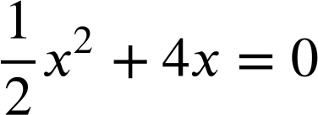
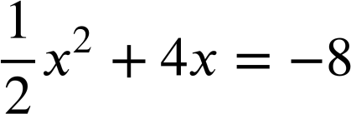
Reading from graphs
3) The Oak pupils plot their age against how many books they have read and find a linear relationship.
a) Use the graph to estimate the age of a pupil who has read 400 books.
600
✖
Books read
(18, 575)
500
≈ 14
400
✖
b) Use the graph to predict how many books a pupil will have read by the time they reach 18.
(14, 400)
300
200
≈ 575
100
Age (yrs)
Task B: Reading from quadratic graphs
1) This is the graph of the quadratic equation
(−10, 10)
✖
y
✖
(2, 10)
Use the graph to solve:
a)
x = −10 and x = 2
✖
✖
(0, 0)
x
(−8, 0)
b)
x = −8 and x = 0
c)
x = −4 one value only
(−4,−8)
✖

Slide 3
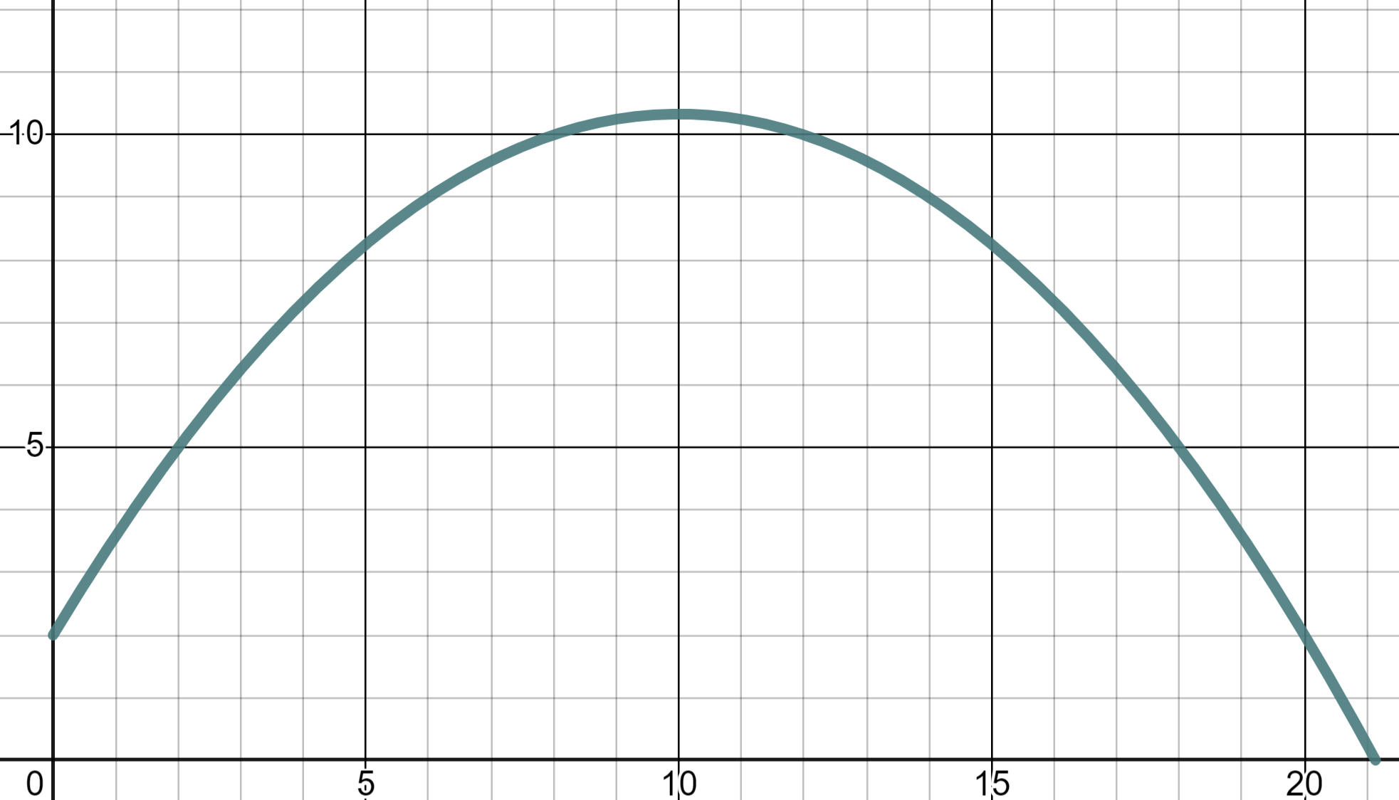
Reading from graphs
2) This parabola models the flight of a cricket ball being thrown.
Use the graph to read:
10
a) The height of the ball at a distance 18 metres.
Height (m)
(6, 9)
✖
(14, 9)
✖
Height = 5 m
b) The distance when the ball is at a height of 9 metres.
5
✖
(18, 5)
Distance = 6 m and 14 m
c) The distance when the ball is at a height of 12 metres.
0
5
10
15
20
The ball never reaches a height of 12 m
distance (m)
Mathematics in Education and Industry
v2.3

